Slide 1
Writing Better SQL Server Applications
Bill Graziano

Slide 2

Bill Graziano
SQL Server DBA for 15 years
As a consultant, experienced a broad variety of applications
Database Administrator as several sites hosting OLTP systems
Former President of PASS
Author of ClearTrace, a tool to analyze performance
billg@scalesql.com
Materials at github.com/billgraziano/kcdc2018

Slide 3





































TITANIUM SPONSORS
Platinum Sponsors
Gold Sponsors

Slide 4
Agenda
Fast SQL
SQL Architecture
Client Applications
Materials at github.com/billgraziano/kcdc2018

Slide 5
Agenda
Writing Faster SQL
Reading query plans, sarge-ability, type mismatches, indexing
Reusing Query Plans
Parameterization, memory usage, parameter sniffing, optional parameters, statistics
TSQL Architecture
Errors, transactions, temp tables, deleting, OUTPUT
Design Tips
Column-store, naming, table design, schema changes
Client Applications
Authentication, Connecting to SQL, Handling data, ORMs
New TSQL Features
DROP & CREATE, splitting strings, formatting, sequences, temporal tables
Materials at github.com/billgraziano/kcdc2018

Slide 6
Downloads
github.com/billgraziano/kcdc2018
PPTs, SQL Scripts, demo apps
Download as ZIP in the upper right corner
github.com/Microsoft/sql-server-samples/releases/tag/adventureworks
AdventureWorks2016.BAK (47 MB)
AdventureWorksDW2016_EXT (883 MB)
You probably don’t need this
All samples use
SQL Server 2016
Visual Studio 2017
Materials at github.com/billgraziano/kcdc2018

Slide 7
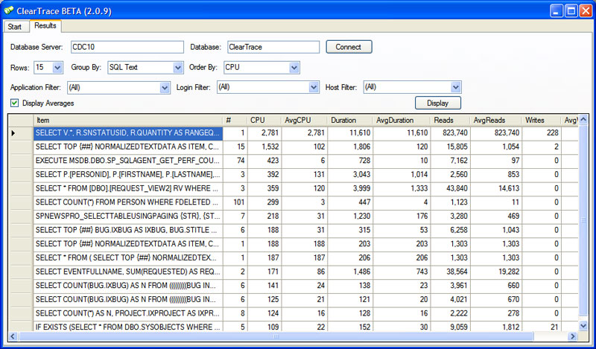
ClearTrace
Free tool to analyze query performance
Groups like statements together
Easy reporting by CPU or disk usage
Quickly identify problem queries
www.scalesql.com/cleartrace
Materials at github.com/billgraziano/kcdc2018

Slide 8
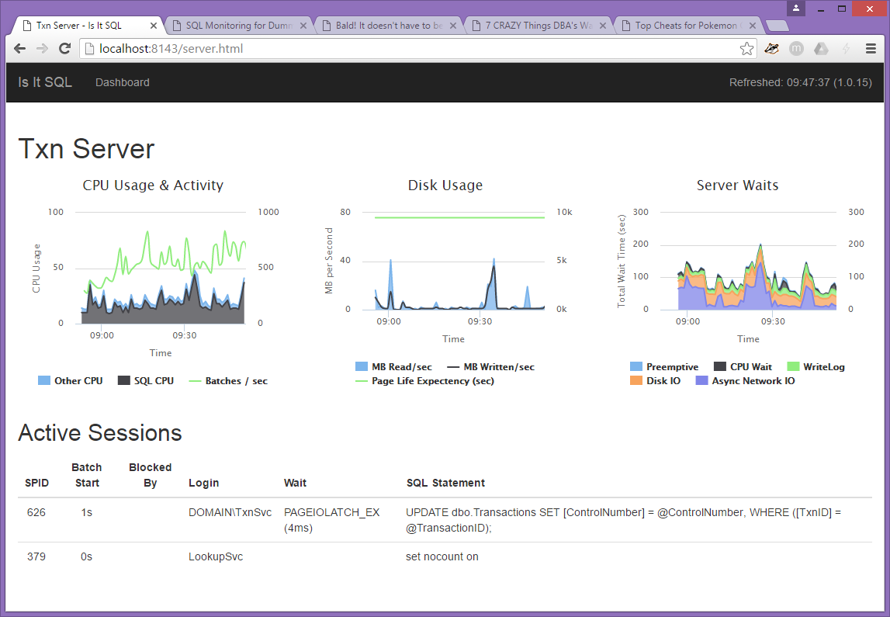
Is It SQL?
Free SQL Server monitoring utility
Agent-less and easy to install
Capture CPU, disk, and waits
Answers “Was it SQL Server?”
www.scalesql.com/isitsql
Materials at github.com/billgraziano/kcdc2018

